Slide 1
Templates & Exception Handling

Slide 2
Templates
It is a method of writing single function or class for family of similar functions or classes in generic manner.
Example:
swap(char * , char *) //swapping 2 character data-types
swap( int , int) //swapping 2 integer quantities
swap( float , float) //swapping 2 float quantities
Here, c++ provides functionality to write single function for group of similar functions called “Function Template”.
Advantage → avoid repetition of source code.

Slide 3
Function Template
template <class T>
T function_name ( T formal_arguments)
{
-----------
return(T);
}

Slide 4
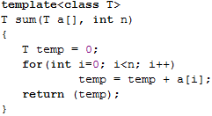
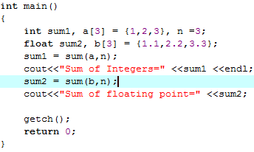
Function Template example

Slide 5
Class Template
It is class definition that describes family of related classes.
template <class T>
class user_defined_name
{
private:
--------
public:
-------
};

Slide 6
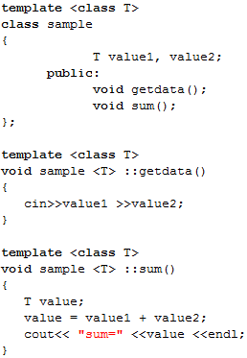
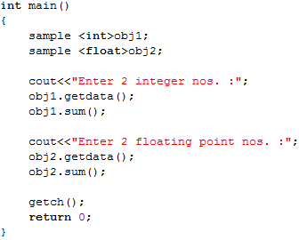
Class Template example

Slide 7
Exception Handling
An exception is an error or unexpected event.
Exception handler is a set of codes that is executed when an exception occurs.
It helps to detect and manage run-time errors.
Following keywords are used:
  try
  catch
  throw

Slide 8
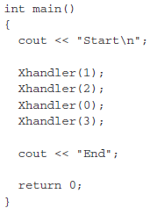
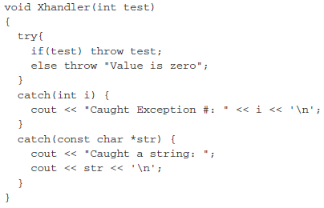
Multiple catch statements

Slide 9
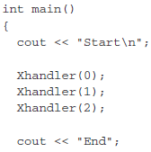
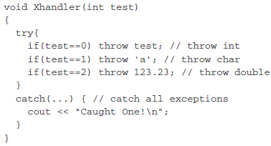
Catching all exceptions

